Slide 1
Not My Forte Piano
By: Team Not My Forte Piano
Jake Hamblin, Nick Latham, Vaibhav Patel, Alexander Shampton, and Alex Yeoh

Slide 2
Elevator Pitch
We want to build a browser-based piano game because we feel that it is a void that might be able to be filled. While there are a number of app-equivalent games, not many are browser-based. More importantly, most of them do not offer a Guitar Hero-style of gameplay. The game will include a sandbox mode, an interactive timing-based skill mode, and a follow-along mode. Users will be able to select between many formats of gameplay, from casual to more in-depth, competitive styles, allowing nearly everyone to have an interest in the game.

Slide 3
Overview
The architecture of our piano game consists of four modules:
User Interface (Alexander Shampton)
Front End (Jake Hamblin)
Back End (Alex Yeoh)
High Scores tables and songs directory (Nick Latham)
The testing plan was created by Vaibhav Patel
Notes:
This is our general architecture, with UI done by Shampton, the front end done by Hamblin, the back end done my me, high score tables and song directories done by Latham, and testing done by patel.

Slide 4
Piano Logic (Alex Yeoh)
User Story As a musician, when I play a song in the song mode and don’t get a high score, I want to receive feedback so I can understand how to improve and try again.
Requirement The system shall have functionality to play a song again in Play Music.
Notes:
The user story is that of a musician who wants to be able to improve using our piano game; to do that, we made the requirement that a user is able to replay songs.

Slide 5
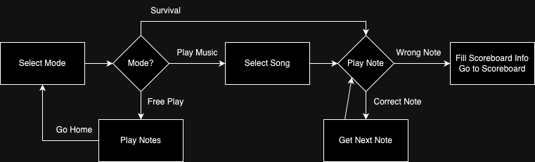
Piano Logic Diagram
Notes:
This is how our backend is generally laid out, we start off selecting a mode, if the user selects free play, they’re allowed to play until they’re happy and then change mode. If they select survival, they have to play specific notes until they get one wrong which will then move them to the scoreboard. For play music mode, it’s like survival mode except that the user needs to select a song first and that it’ll exit upon song completion.

Slide 6
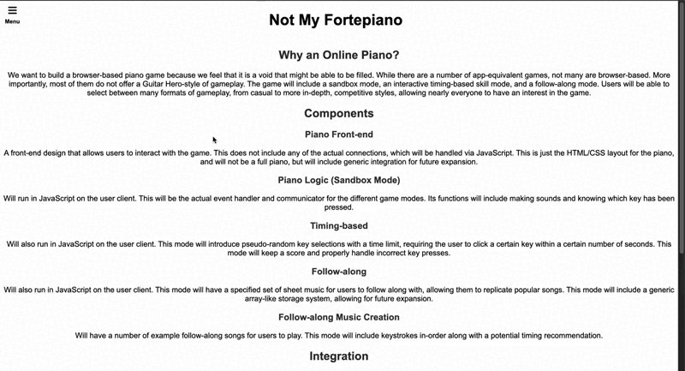
Notes:
This is a gif of everything generally working that has been sped up by 3x

Slide 7
High Score Table (Alex Shampton)
User Story:
As a competitive gamer, I want to be challenged by other survival mode players' high scores, even if I cannot beat their scores.
Requirements:
The system shall have a leaderboard that contains scores
The system shall have a leaderboard that shows all highscores

Slide 8
High Score Table (Alex Shampton)
Design Specification:
The frontend shall have a menu that allows the user to select between "free-play", "survival", "play song", and "see high scores" modes. This shall be contained within a menu, so the user may select which mode to play in.

Slide 9
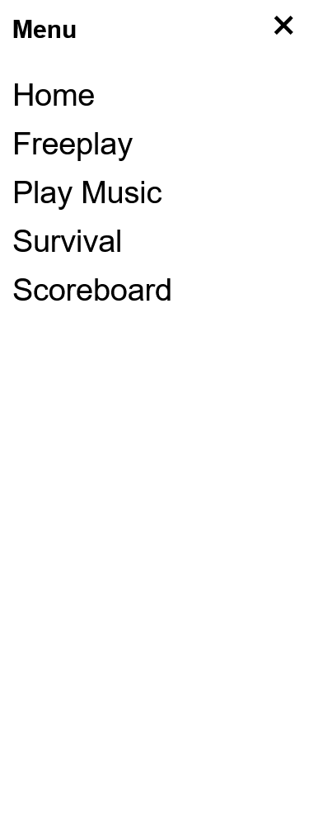
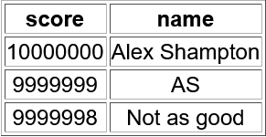
High Score Table (Alex Shampton)

Slide 10
Play Along (Jake Hamblin)
User Story:
As a competitive musician, I want to be able to play a provided song and get a high score so I can compete for the best score.
Requirement:
The system shall have a song selection menu
The system shall allow the user to input their score into the leaderboard for Play Music mode

Slide 11
Play Along (Jake Hamblin)
Design Specification:
The system shall have a database for songs. These songs will be broken down into notes that the front end will display to the user. The backend shall keep track of the number of notes the user plays that correctly correspond to the notes of the song, and determine the user's score based on the this.

Slide 12
Play Along (Jake Hamblin)
Select song
Read song database
Show notes to play
Determine if correct note played
End collects name and sets score
Score appears in leaderboard

Slide 13
Notes:
Speed up 3x

Slide 14
Free Play (Nick Latham)
User Story:
As an aspiring musician, I want to be able to select and use the Free Play mode to experiment with writing my own music.
Requirements:
The system shall contain a Free Play mode
The system shall contain a menu selection for Free Play mode

Slide 15
Free Play (Nick Latham)
Design Specification:
The logical components of the system shall have logic to allow the user to play individual piano notes. The notes will be acquired from a MIDI file and each piano key will correspond to its proper note.

Slide 16
Free Play (Nick Latham)
Select Free Play mode from Menu
User presses a key
Front end sends note pressed to back end
Back end returns note sound to front end
Note is played
Continue sending and returning the notes the user presses until user decides to quit and return to Menu

Slide 17
Free Play (Nick Latham)
@app.route("/freeplay")
def render_freeplay():
session["mode"] = "freeplay"
session["previous_note"] = 60 # default start note is middle c
session["score"] = 0
return render_template("freeplay.html", mode="freeplay")

Slide 18
Survival mode (Vaibhav Patel)
User story:
As a gamer, I want to be able to play survival mode and save my scores into a leaderboard, so I can see my progress as I get better.
Requirements:
The system shall contain a survival Play mode
The backend shall handle the logic for checking high scores and updating the leaderboard.

Slide 19
Survival mode (Vaibhav Patel)
Design Specification:
The design specification for the user story will involve implementing Survival mode where the user can play and track their score. If the score qualifies as a high score, the system will prompt the user to enter their name and save the score to a leaderboard stored in database. The game will allow players to see their progress after each session.

Slide 20
Survival mode (Vaibhav Patel)
Select Survival mode from Menu
The front end initiates Survival mode gameplay
The backend calculates the score and checks if it qualifies as a high score based on performance
If the score is a high score, the front end prompts the user to input their name, and the backend saves it to the leaderboard
After saving the score or returning to the menu, the user is taken back to the main menu.

Slide 21
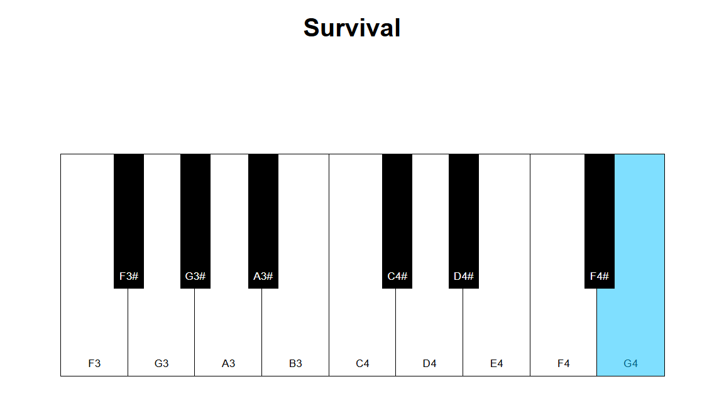
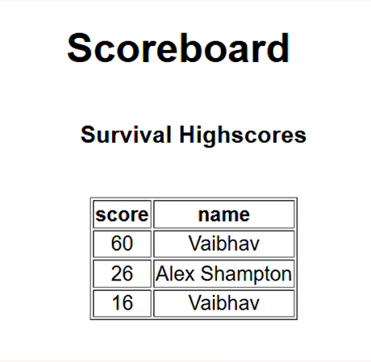
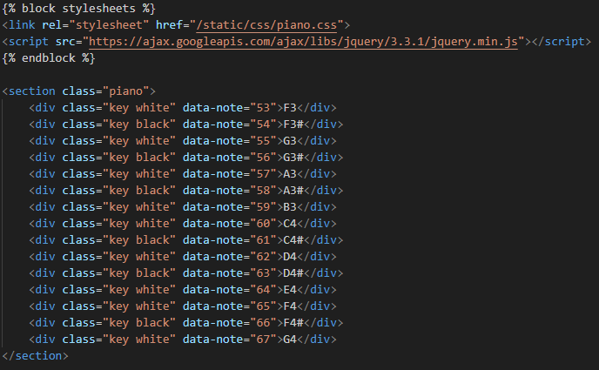
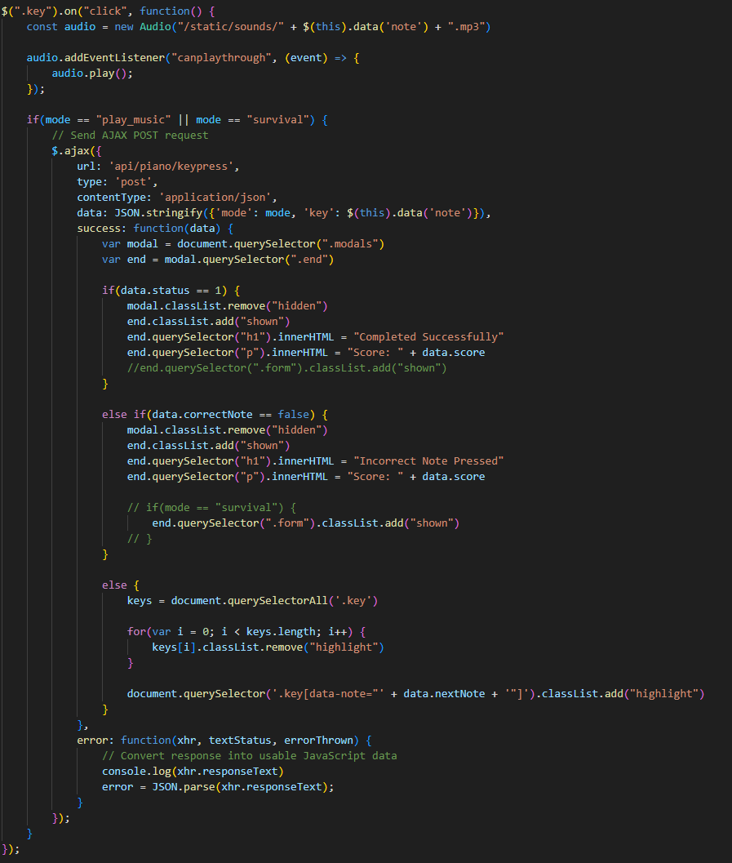
Updated Score
Old Score

Slide 22
Testing Plan (Vaibhav Patel)
Testing Plan for Game Modes:
Testing requirements for all game modes: Survival Mode, Play Music Mode, Free Play Mode
Focus on functionality, score handling, user interface, and database interactions
Mode Selection Testing:
Test if user can select between modes (Survival, Play Music, Free Play, High Scores)
Test if each mode loads properly upon selection

Slide 23
Testing Plan (Vaibhav Patel)
Gameplay Functionality Testing:
Survival Mode: Verify correct start, score tracking, leaderboard integration, name input for high scores
Play Music Mode: Test song selection, score calculation, leaderboard display
Free Play Mode: Ensure free play starts and ends correctly with no score tracking

Slide 24
Testing Plan (Vaibhav Patel)
Score and Leaderboard Testing:
Verify leaderboard displays high scores for Survival and Play Music modes
Ensure scores are stored and retrieved correctly from the database
Test functionality to overwrite scores with higher scores

Slide 25
Testing Plan (Vaibhav Patel)
Database and Data Persistence Testing:
Verify database is storing scores, song data, and user names correctly
Ensure data persistence across gameplay sessions
Test data retrieval for songs and leaderboard

Slide 26
Testing Plan (Vaibhav Patel)
User Interface (UI) Testing:
Test the piano-style keyboard GUI in each mode
Validate menu navigation between modes (Survival, Play Music, Free Play)
Ensure score input popup for high scores functions correctly

Slide 27
Testing Plan (Vaibhav Patel)
Error Handling & Performance Testing:
Test error handling for invalid inputs and database failures
Ensure the game runs smoothly across platforms (PC, mobile, browsers)
Endgame & Session Flow Testing:
Ensure correct redirection to the main menu after gameplay
Test smooth transition between game modes and exit functionality

Slide 28
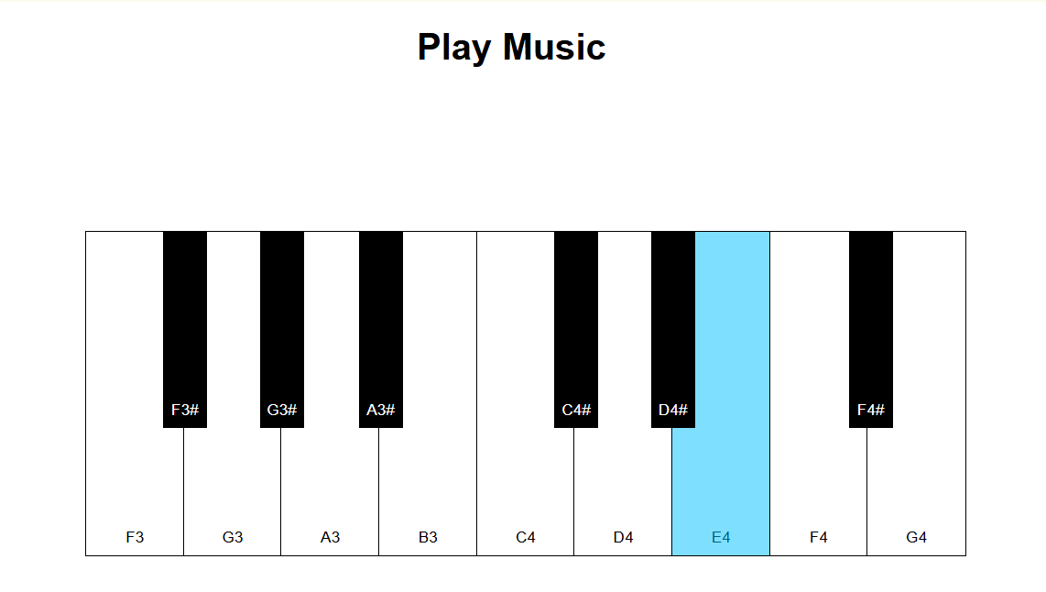
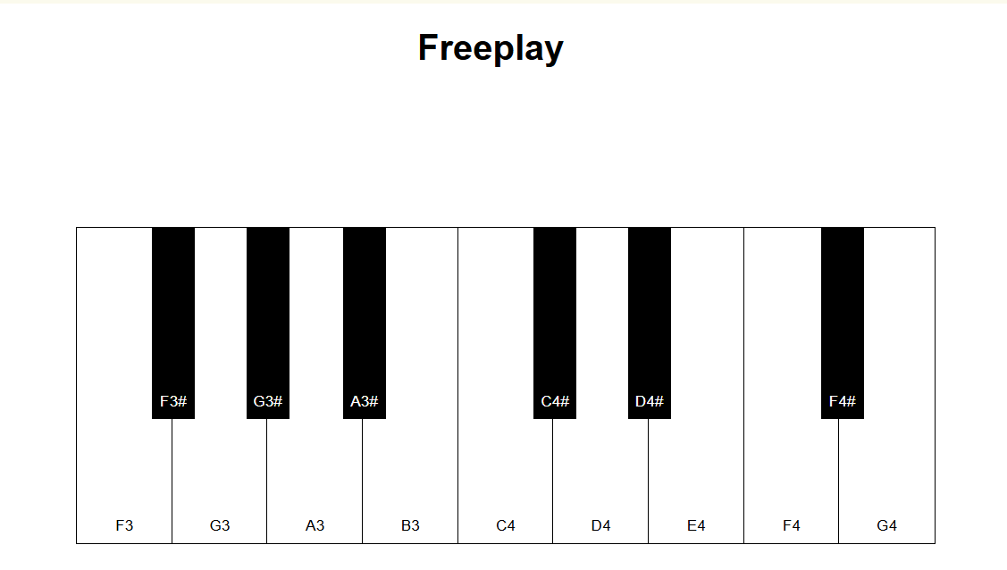
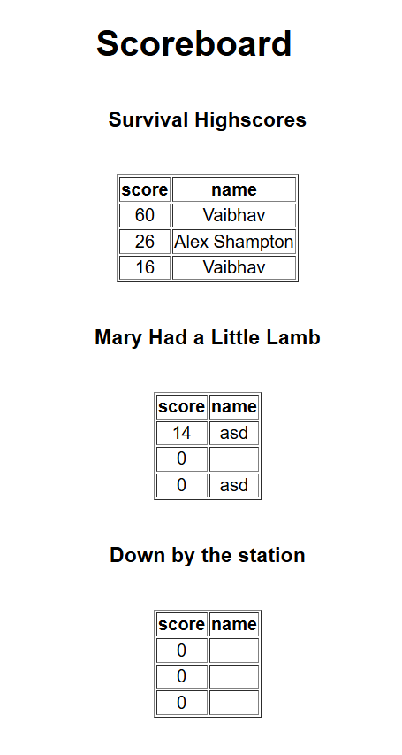
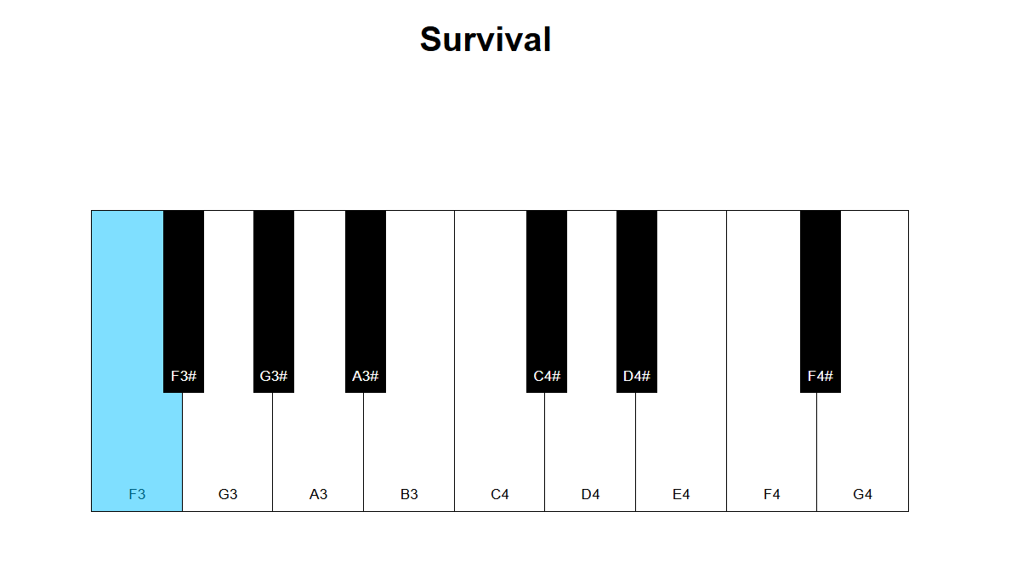
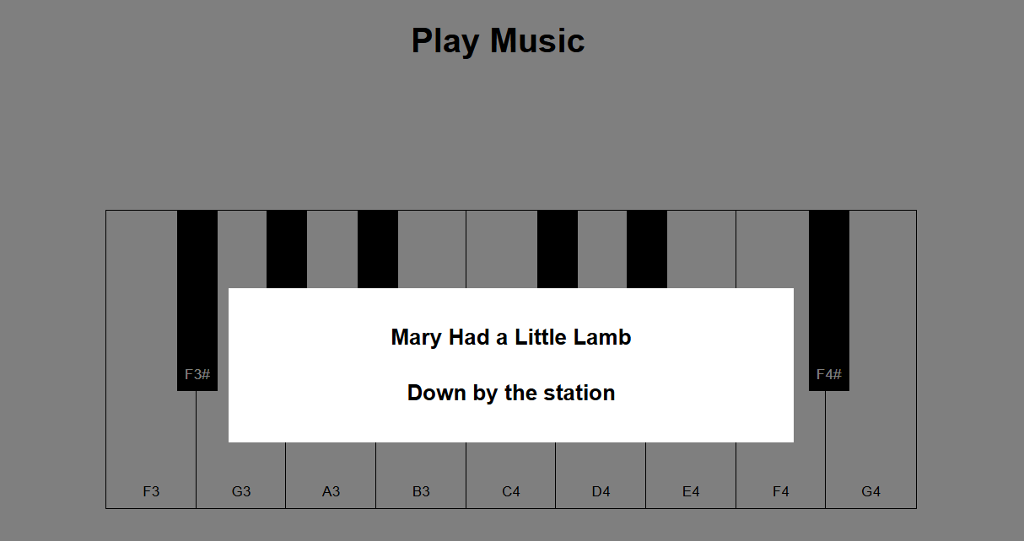

Slide 29
Conclusion
We have created a browser-based piano game that offers three different modes of Guitar Hero-style play and keeps scores for the user. The game we have created can be enjoyed by anyone from experienced musicians to competitive gamers.

Slide 30

Questions?

